Slide 1

Finding The Best Apartment to Rent in Manhattan N.Y
2
+
2
+

Slide 2
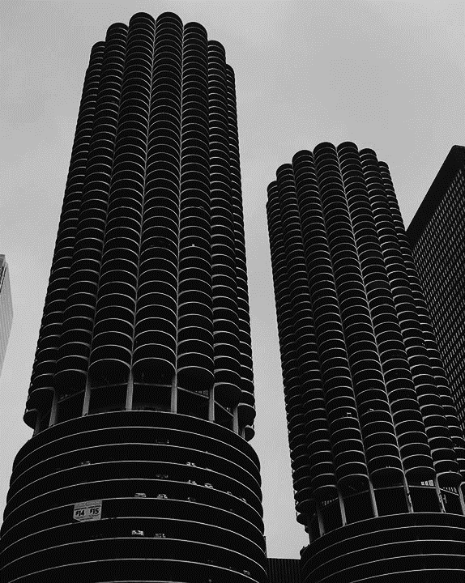
Motivation and background
2
+
Background: I am a third-year Ph.D. student currently living in Paris. Paris is a living city with a lot of diverse venues, in addition, the public transportation system in Paris is very efficient and well managed, It is very easy to go from point A to point B regardless of the location of these two points. However, renting an apartment in Paris is very expensive, and it varies highly according to the boroughs.

Slide 3
Motivation and background
2
+
Motivation: I have been offered a great opportunity to work in Manhattan, NY. Although I am very excited about it, I want to make sure to find a similar neighborhood to the one I am currently living at. I am interested in venues, metro station proximity, and apartment prices. On a personal level, I believe that this project is a good practice towards the development of my Data Science skills.

Slide 4

Objective
2
+
My objective is to to find an apartment to rent in Manhattan NY under certain conditions:
The apartment rental price should be within my 7000-8000 US $ Budget.
The Neighborhood where the apartment is located should have similar venues to the one I am currently living in.
The apartment should not be too far from the nearest metro station (within 500m).

Slide 5
The required data
In order to make a final decision on which apartment to rent in Manhattan NY, the following data is required:
Information on Manhattan's neighborhoods alongside the coordinates of each neighborhood(latitude, longitude).
Information on the subway metro stations in Manhattan (location, coordinates).
a List of apartments that are published for rent in the Manhattan area with descriptions (price, location, address, etc..)
List of venues in the Manhattan neighborhoods (e.g. top 10)

Slide 6
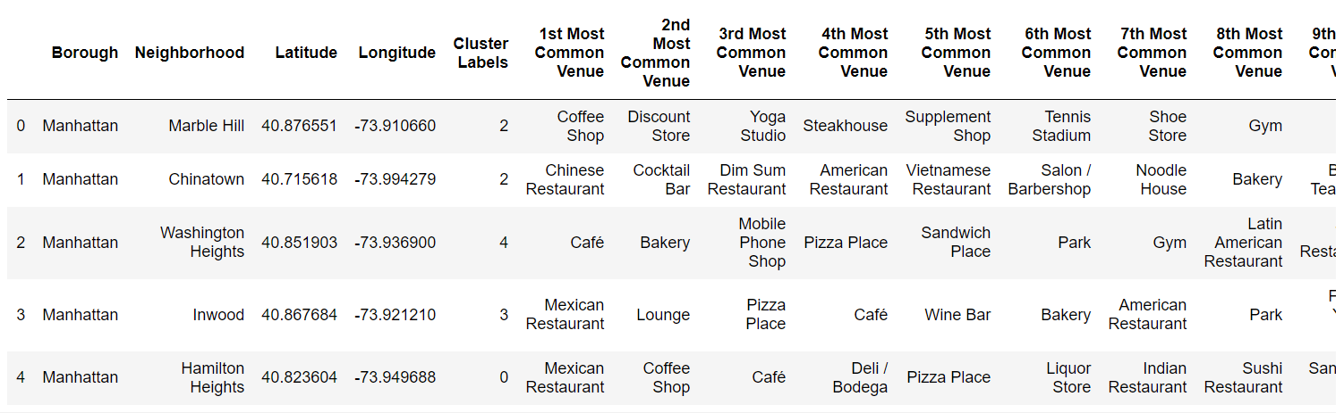
Manhattan neighborhoods: location, cluster number, and top 10 venues
2
+

Slide 7
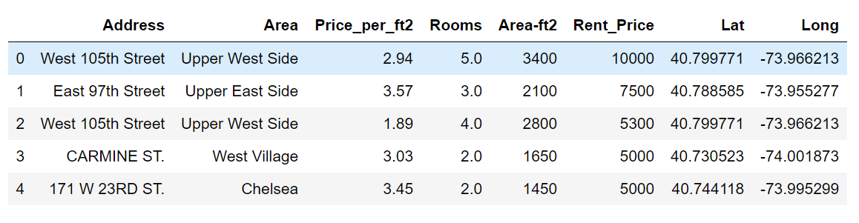
Flat prices and location
2
+

Slide 8
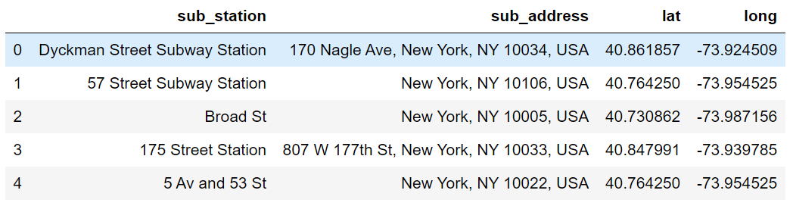
Subway stations name and location
2
+

Slide 9
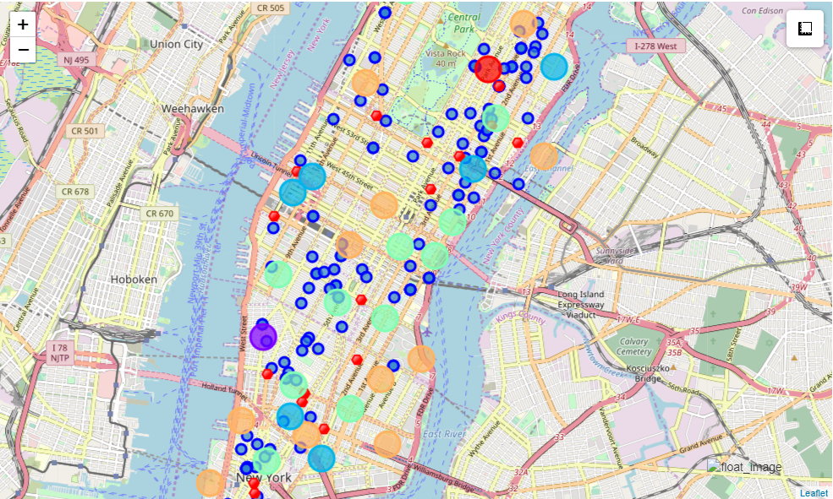
The Final map

Slide 10
Appartement selection
2
+
Using the consolidate map we will explore our options. Let's say I am interested in living in neighborhoods belonging to Cluster 2 (close to the one I currently live in Paris). And my budget is limited to 7000-8000 US Dollars a month.
Here are 3 options (there are obviously more, I will just give 3 examples):
Neighborhood: Soho, apartment address: 93 Grand Street, Price: 6900, distance to nearest subway station: 461 m.
Neighborhood: Sutton Place, apartment address: 221 East Str60th Street, Price: 8000, distance to nearest subway station: 106 m.
Neighborhood: Morning side Heights, apartment address: 1080 Amsterdam Avenue, Price: 7792, distance to nearest subway station: 2297 m.

Slide 11
Appartement selection
2
+
Option 3 is not to be considered. too far away from a subway station.
Am I willing to pay 1100 US dollars more to live in an apartment that is closer to a subway station (option 2)?
I don't think it worth it, walking a 300m hundred meters (roughly 4 minutes) to save 1100 dollars is a good deal. Therefore I will stick to option 1

Slide 12
Conclusion
A comprehensible easy to use tool was presented. It enables a person moving to Manhattan to find similar neighborhoods to the one he is currently living in with the right rental price.
For future work, in order to improve this tool, more features could be added, such as population density, crime rates in each neighborhood, and distance to work form each apartment.

Slide 13
Thank you
2
+
2
+
Gaby Bou Tayeh

Slide 14
Personnaliser ce modèle
Instructions en matière de modification du modèle et commentaires

